Slide 1

*****
AirBnB Project
- Milan
Presented by Group 5

Slide 2
Data Summary
01
02
Character
Date
03
04
Logical
Numeric
24 character data
E.g. name, listing_url, description and host_name
5 date data
E.g. host_since, last_scraped, frist_review, last_reveiw
8 logical data
Take a certain value based on a logical test
E.g. bathrooms, host_is_superhost, instant_bookable
37 numeric data
E.g. host_listings_count, latitude, accommodates, beds, minimum_nights and availability_60
AirBnB analytics

Slide 3
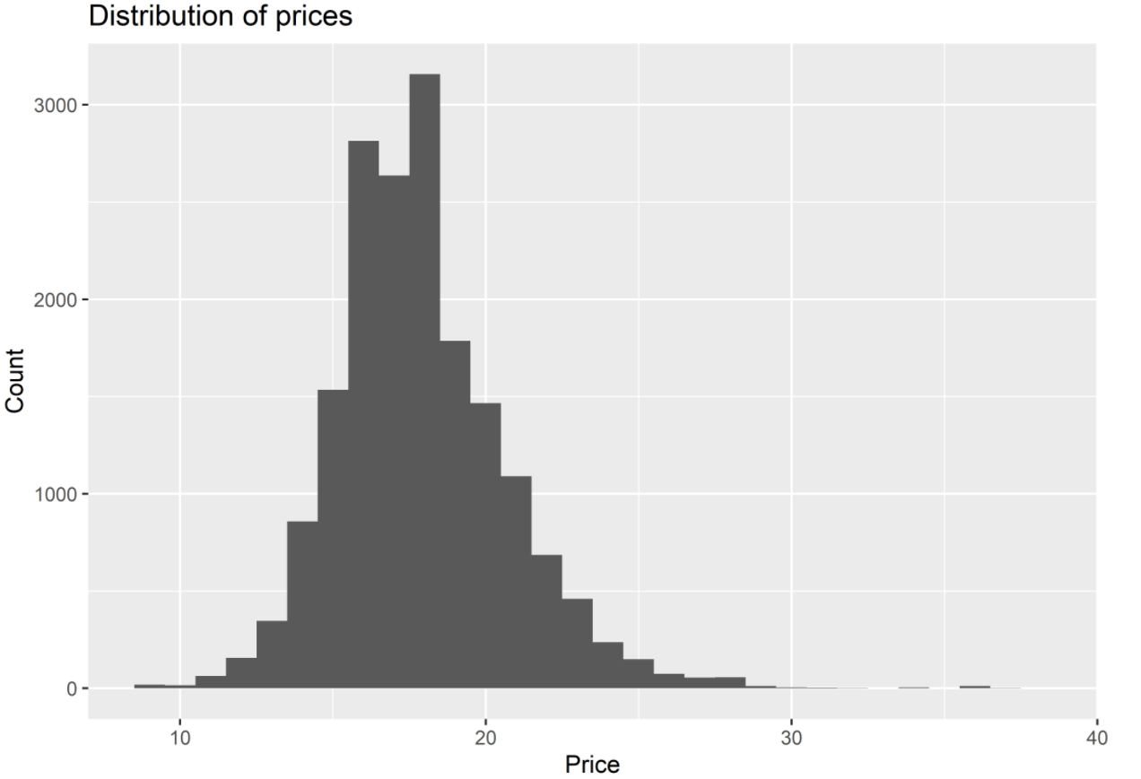
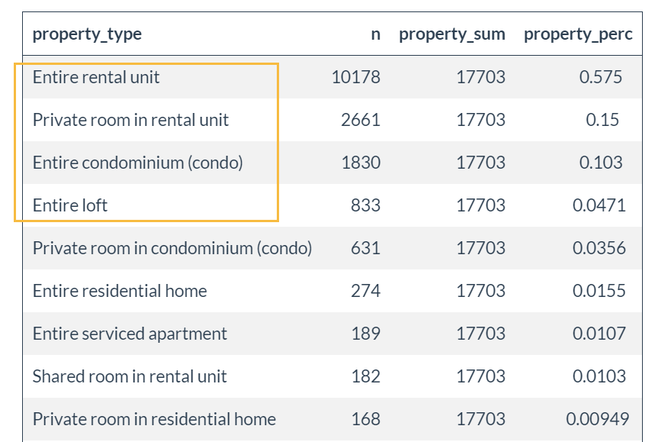
Property Types
52 unique property types
Top 4 most common property types make up more than 85% of total properties types
Price Distribution
Due to the highly right-skewed distribution of the original price data, we introduced a new variable to better capture price range and formed a log distribution
-- a large group of outliers was detected
AirBnB analytics

Slide 4
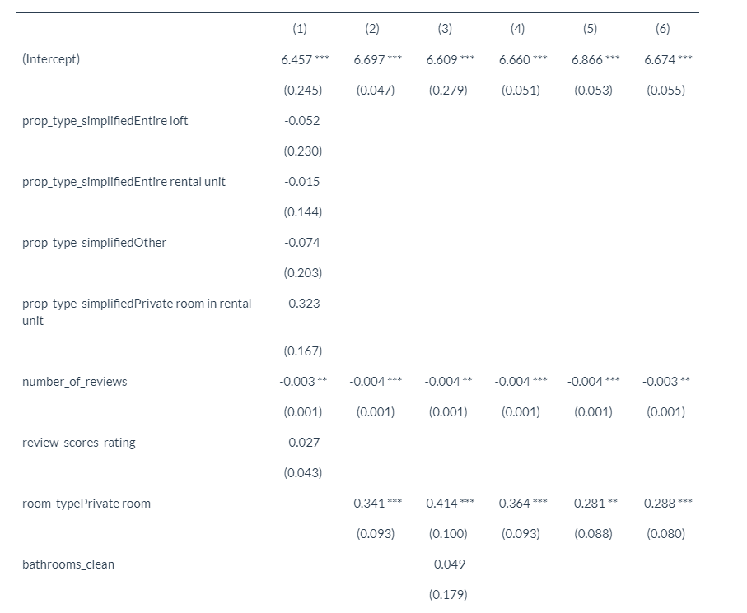
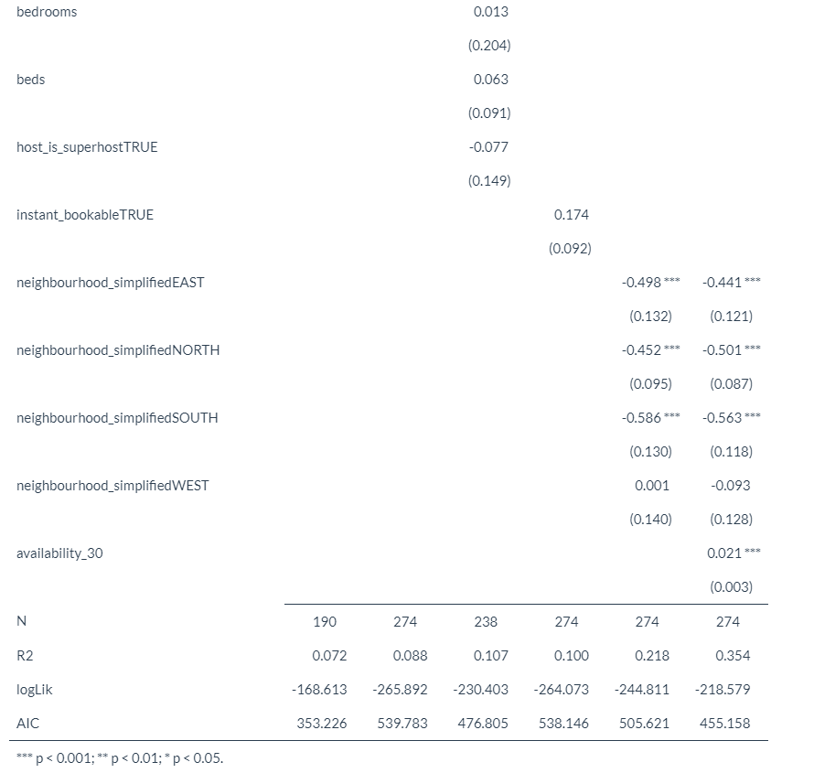
Comparison of 6 Models, including model names, significant predictors, adjusted R^2 and the Residual Standard Error
AirBnB analytics

Slide 5
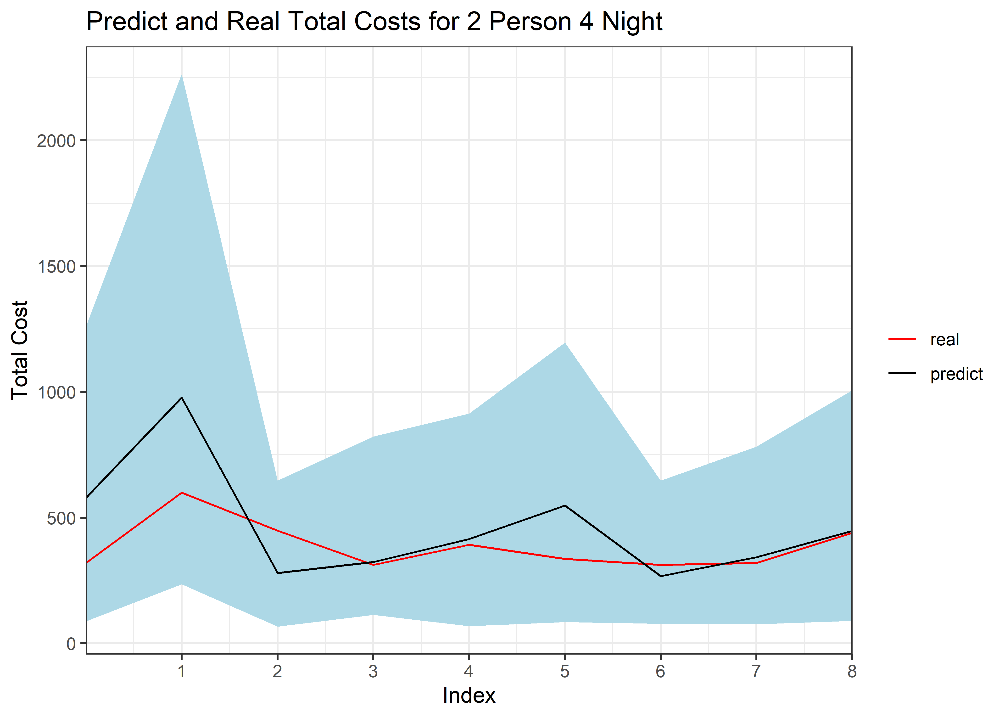
Best Model – model6.2
fitted line fluctuates around the real line, which is within the range of 95% confidence interval
highest R-squared (0.354)
best fits our observations
AirBnB analytics

